Slide 1
“EVERYONE SPEAKS ENGLISH!”
Notes:
Introductions – yes, people do speak English, but not everyone does.

Slide 2
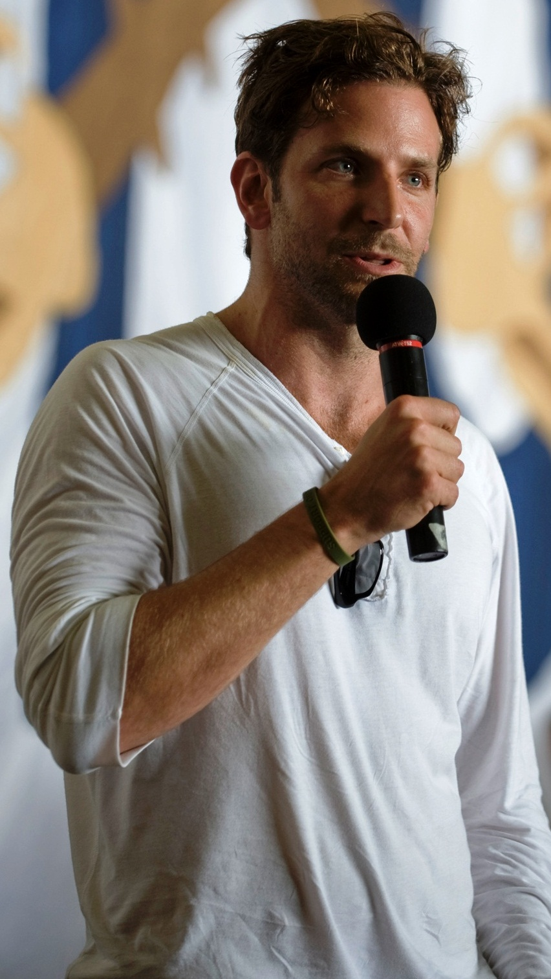
THEY ALL SPEAK MORE THAN ONE LANGUAGE!
What do these celebrities have in common?

Slide 3
NATALIE
PORTMAN
BRADLEY
COOPER
SHAKIRA
Notes:
Bradley Cooper / Shakira conduct interviews in multiple languages, despite not being fluent. Natalie Portman is fluent in Hebrew and English, but still learns other languages.

Slide 4
BRADLEY COOPER SPEAKING FRENCH – A STAR IS BORN INTERVIEW ‘QUOTIDIEN’
SHAKIRA SPEAKING 5 LANGUAGES
15 CELEBS SPEAKING OTHER LANGUAGES

Slide 5
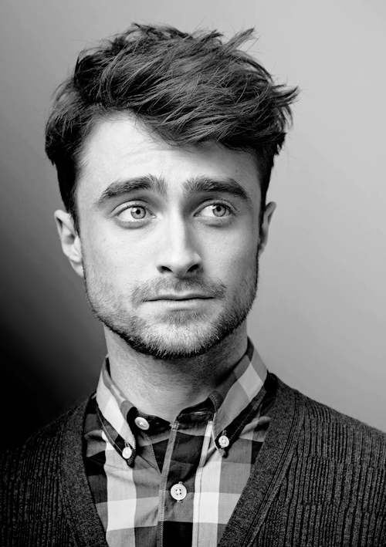
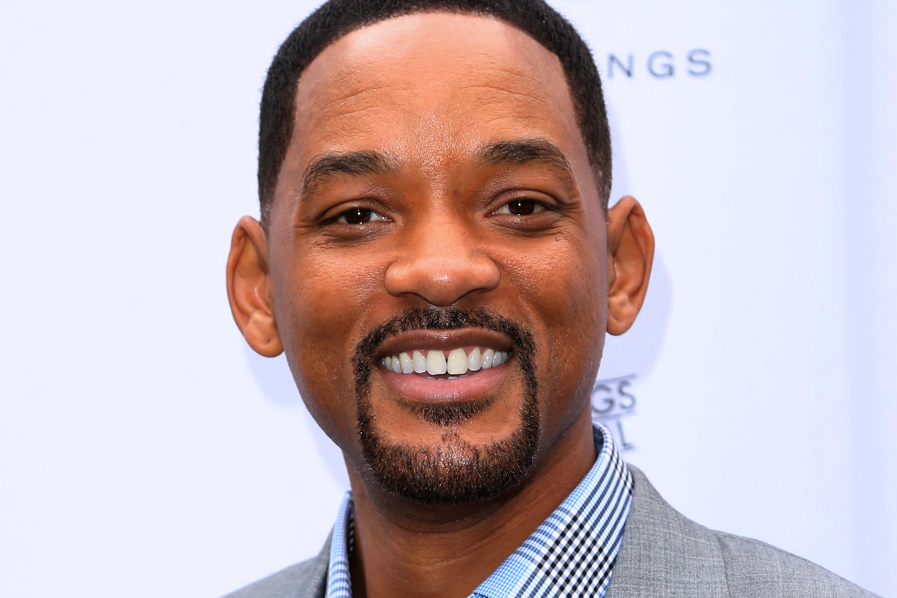
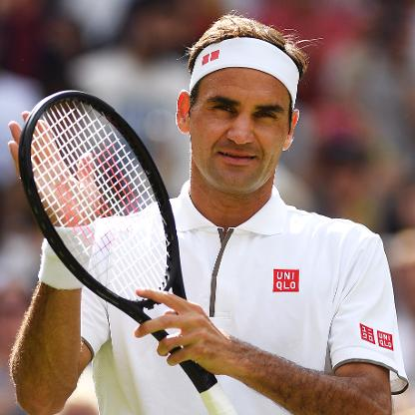
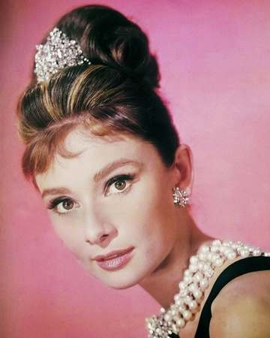
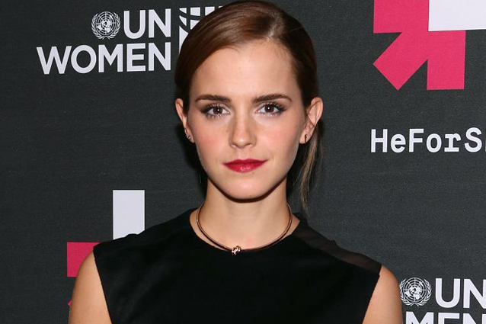
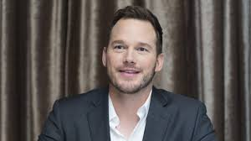
Just because celebs speak other languages, why should I?!
Notes:
All of these celebs speak more than one language to some level.

Slide 6
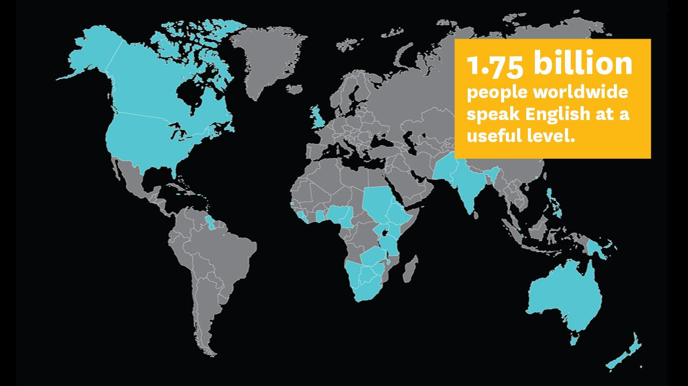
WHY LEARN A LANGUAGE?
Chinese — 1.3 Billion Native Speakers
Spanish — 460 Million Native Speakers
A: COMMUNICATION
English — 379 Million Native Speakers
FRENCH — 220 Million Native Speakers
German — 100 Million Native Speakers
Notes:
6 REASONS, starting off with communication. There are more Chinese and Spanish speakers in the world and almost as many French and German speakers combined!

Slide 7
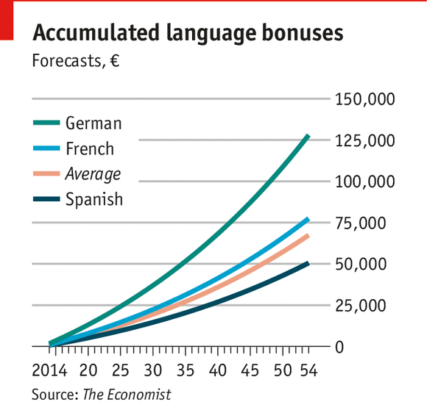
B. POTENTIAL TO EARN MORE MONEY
EARN EXTRA MONEY
Guide
Translator
Private Tutor
Interpreter

Slide 8
C. TRAVELLING
Make travelling more enjoyable
Understand other cultures
Learn about and respect differences
Understand foreign song lyrics!

Slide 9
D. CHALLENGE

Slide 10
E. STUDY ABROAD

Slide 11
F. IMPROVE YOURSELF

Slide 12
G: UNDERSTAND ENGLISH BETTER

Slide 13
“You live a new life for every
language you speak.
If you only know one language,
you only live once.”
- Czech Proverb

Slide 14
“Those who know nothing of foreign languages know nothing of their own.”
– Johann Wolfgang von Goethe

Slide 15
“If you talk to a man in a language he understands, that goes to his head. If you talk to him in his language, that goes to his heart.”
– Nelson Mandela

Slide 16
“One language sets you in a corridor for life.
Two languages open up every door along the way.”
- Frank Smith

Slide 17
“The limits of my language are the limits of my world.”
- Ludwig Wittgenstein

Slide 18
“NOT EVERYONE SPEAKS ENGLISH!”
Communication
Study Abroad
Earning Potential
Improve Yourself / Challenge
Travelling
Better Understanding
Notes:
Introductions – yes, people do speak English, but not everyone does.

