Slide 1
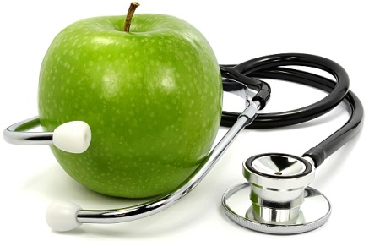
WHAT CAN YOU REMEMBER CHALLENGE? RETRIEVAL PRACTICE
last lesson (1 point)
Take turns -
What can you score
in 5 minutes?
last week (2 points)
two weeks ago (3 points)
a while ago (4 points)
5 body parts
above the shoulders
with correct gender
Outline
3 ways to remain
healthy
List 10 sporting
activities
Name
3 things connected
to the leg
You are at the doctor’s
surgery with
multiple problems.
Talk about it in detail
What should someone
who is overweight do
to lose weight?
Explain how:
,Meine Nase tut
mir weh’ changes in
past tense
Explain what type of
lifestyle you and your
family lead and why
Describe your
neighbour’s body

