Slide 1
Taking Responsibility
DOING THE RIGHT THING
Notes:
https://www.youtube.com/watch?v=oBIxScJ5rlY
https://m.youtube.com/watch?v=PT-HBl2TVtI

Slide 2
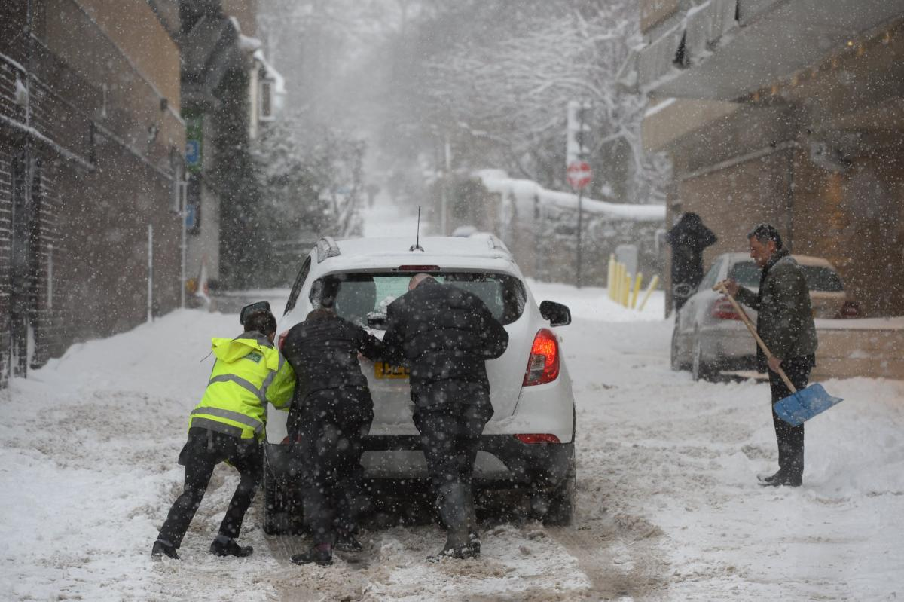
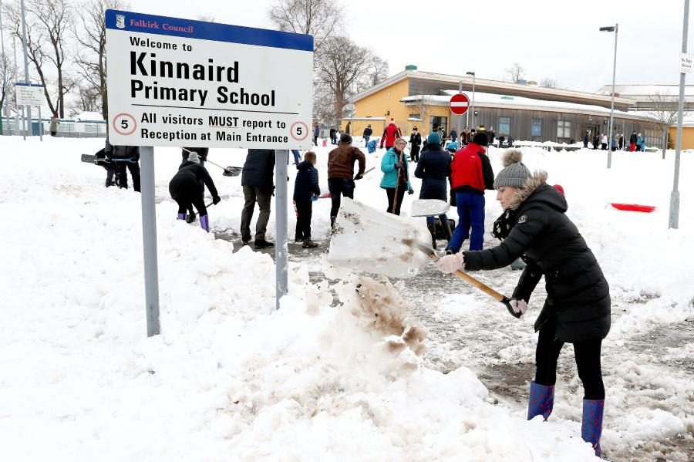
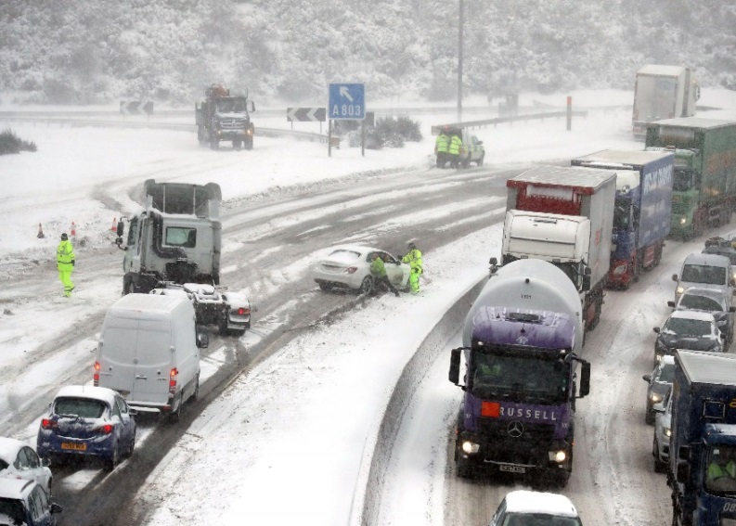
RECENT SNOWSTORMS IN SCOTLAND

Slide 3
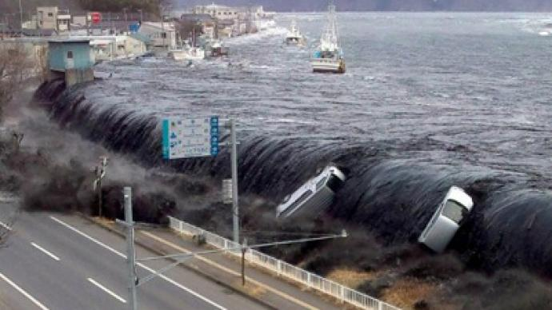
NATURAL DISASTERS

Slide 4
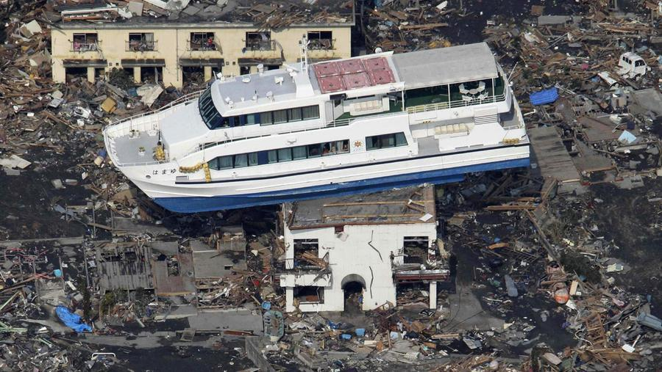
NATURAL DISASTERS

Slide 5
PROMOTING CHANGE IN SOCIETY

Slide 6
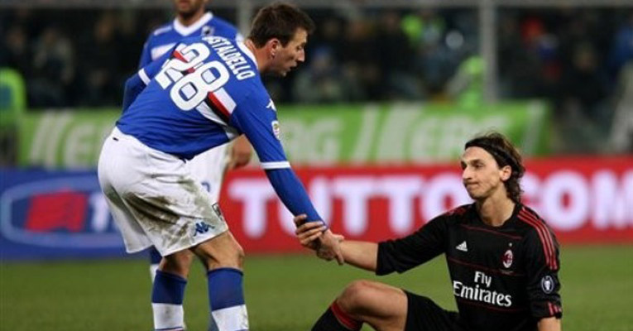
SPORTSMANSHIP
Notes:
https://www.youtube.com/watch?v=EWdf5ZLbtYo
https://www.youtube.com/watch?v=MjfHuAVig9g

Slide 7
Notes:
https://www.youtube.com/watch?v=_pCtXRP1edo

Slide 8
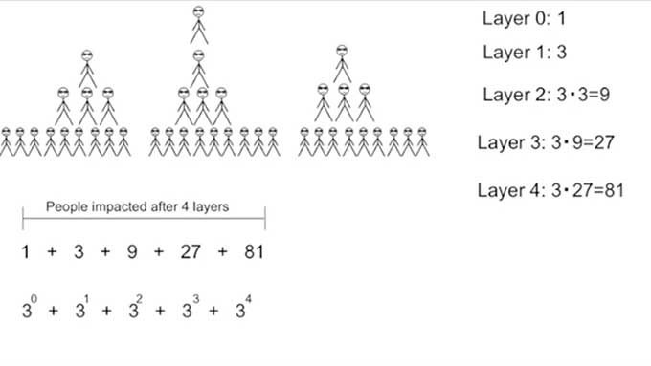
QUESTION: If you help 3 people and they help another 3 people etc... How many people will have been impacted after 4 layers?

Slide 10
Gamlyn House Assembly on Friday 16th March 2018

Slide 12
WE WILL ROCK YOU
Many thanks to all the Gamlyn students who were involved in
Georgia
Georgina
Richard

Slide 13
HOUSE TEAM 2018/ 2019
HOUSE CAPTAIN
DEPUTY HOUSE CAPTAIN
SPORTS CAPTAIN
CHARITY CAPTAIN
QUIZ CAPTAIN
STUDENTS’ VOICE
ADMINISTRATION CAPTAIN
GAMLYN NEWSLETTER/ FROG UPDATES
PLEASE APPLY BY NEXT FRIDAY IN WRITING OR BY E-MAIL

Slide 14
Do you have the community spirit?
The importance of community and being kind. Why do we need community? What has been achieved by being kind? Some real life examples of community and kindness changing lives. Why being kind will pay you back.

Slide 16
House Charity Collection Total
1st
2nd
4th
3rd
5th
6th
7th
TOTAL = £448.45

Slide 17
Inter-House Sport
JMR 5 points each
CH
DAT
SLS 10 points each
TM

Slide 18
The Final
Could Miss Dungarwalla and Noah(representing GOTD) come to the front of the hall

Slide 19
Quiz results
3 points between 1st and 2nd
4 points between 2nd and 3rd
Reminder: Quizzes are sent every week 1 Tuesday by email, and must be completed by the end of form, otherwise the score will not be counted!

Slide 20
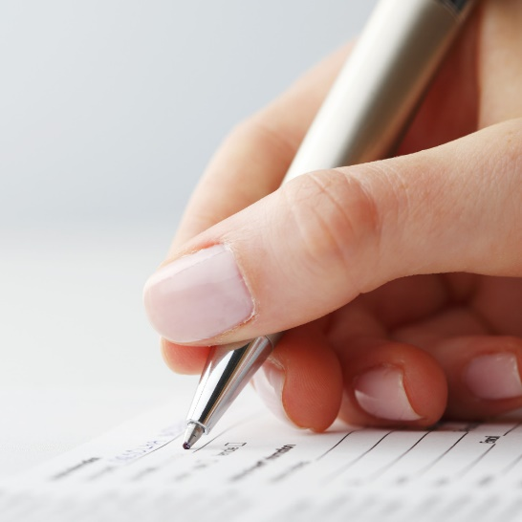
Another Very Busy Term! Term 4 will end on Wednesday 28th March. Term 5 will start on Monday 16th April WEEK 1
Trial Exams
and CATs
Year 9 Options
Slips returned now
Progress
Evenings
Purple Pages and Reflection
Purple pages should
be completed and
signed
Attendance
Use your planner wisely to note deadlines down to keep track of your responsibilities. PLANNERS SHOULD BE BROUGHT TO FORM PERIODS EVERY DAY
EXCEPT ON ASSEMBLY DAYS.
Notes:
There is lots of different events happening during this term. It is very important that you attend them or stick to the deadlines. Use your planners wisely to note deadlines down to keep track of your responsibilities.

Slide 21
FORTHCOMING EVENTS
Raffle Tickets
Thank you for all your suggestions
A good way to help yourselves and your school community to achieve things that will benefit you all.
Get selling!! And see who can raise the most money!

Slide 22
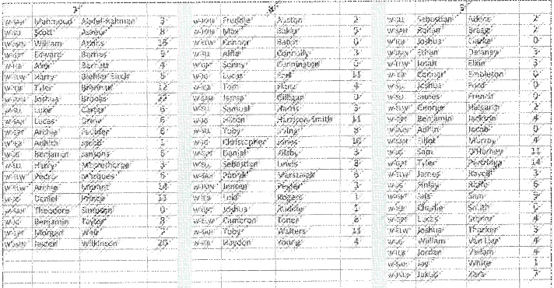
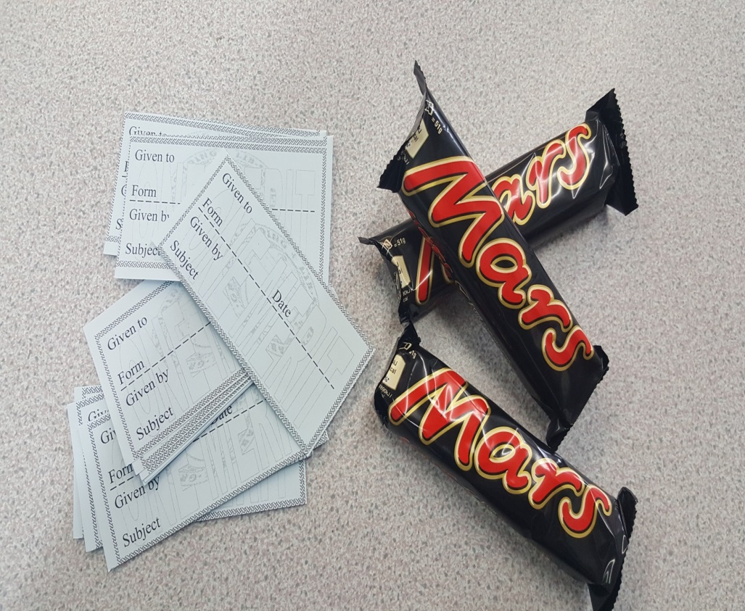
Merits, Commendables and
Mars Bars
Notes:
These are rewarded for many reasons, so please keep up with the good work (classwork, homeworks, efforts, contributions, helpfulness…)

