Slide 1
SCRABBLE VOCAB STARTER
Objective: to revise vocabulary

Slide 2
Was machen wir?
Work individually/in pairs/in small groups
Topic: FAMILIE
Aim: Create as many words in GERMAN, as you can, related to the topic within 3 minutes
Instructions: a) Each team will get points for the value of the letters in each of their words b) The winners will be the students who: - have the most words related to the topic - collect the most points
Rules: - must contain 3+ letters - must be real 'German/French/Spanish/English' words - cannot be proper nouns (names of places/people) - avoid shouting out / looking at others' work - marks may be deducted - teacher's say is final

Slide 3
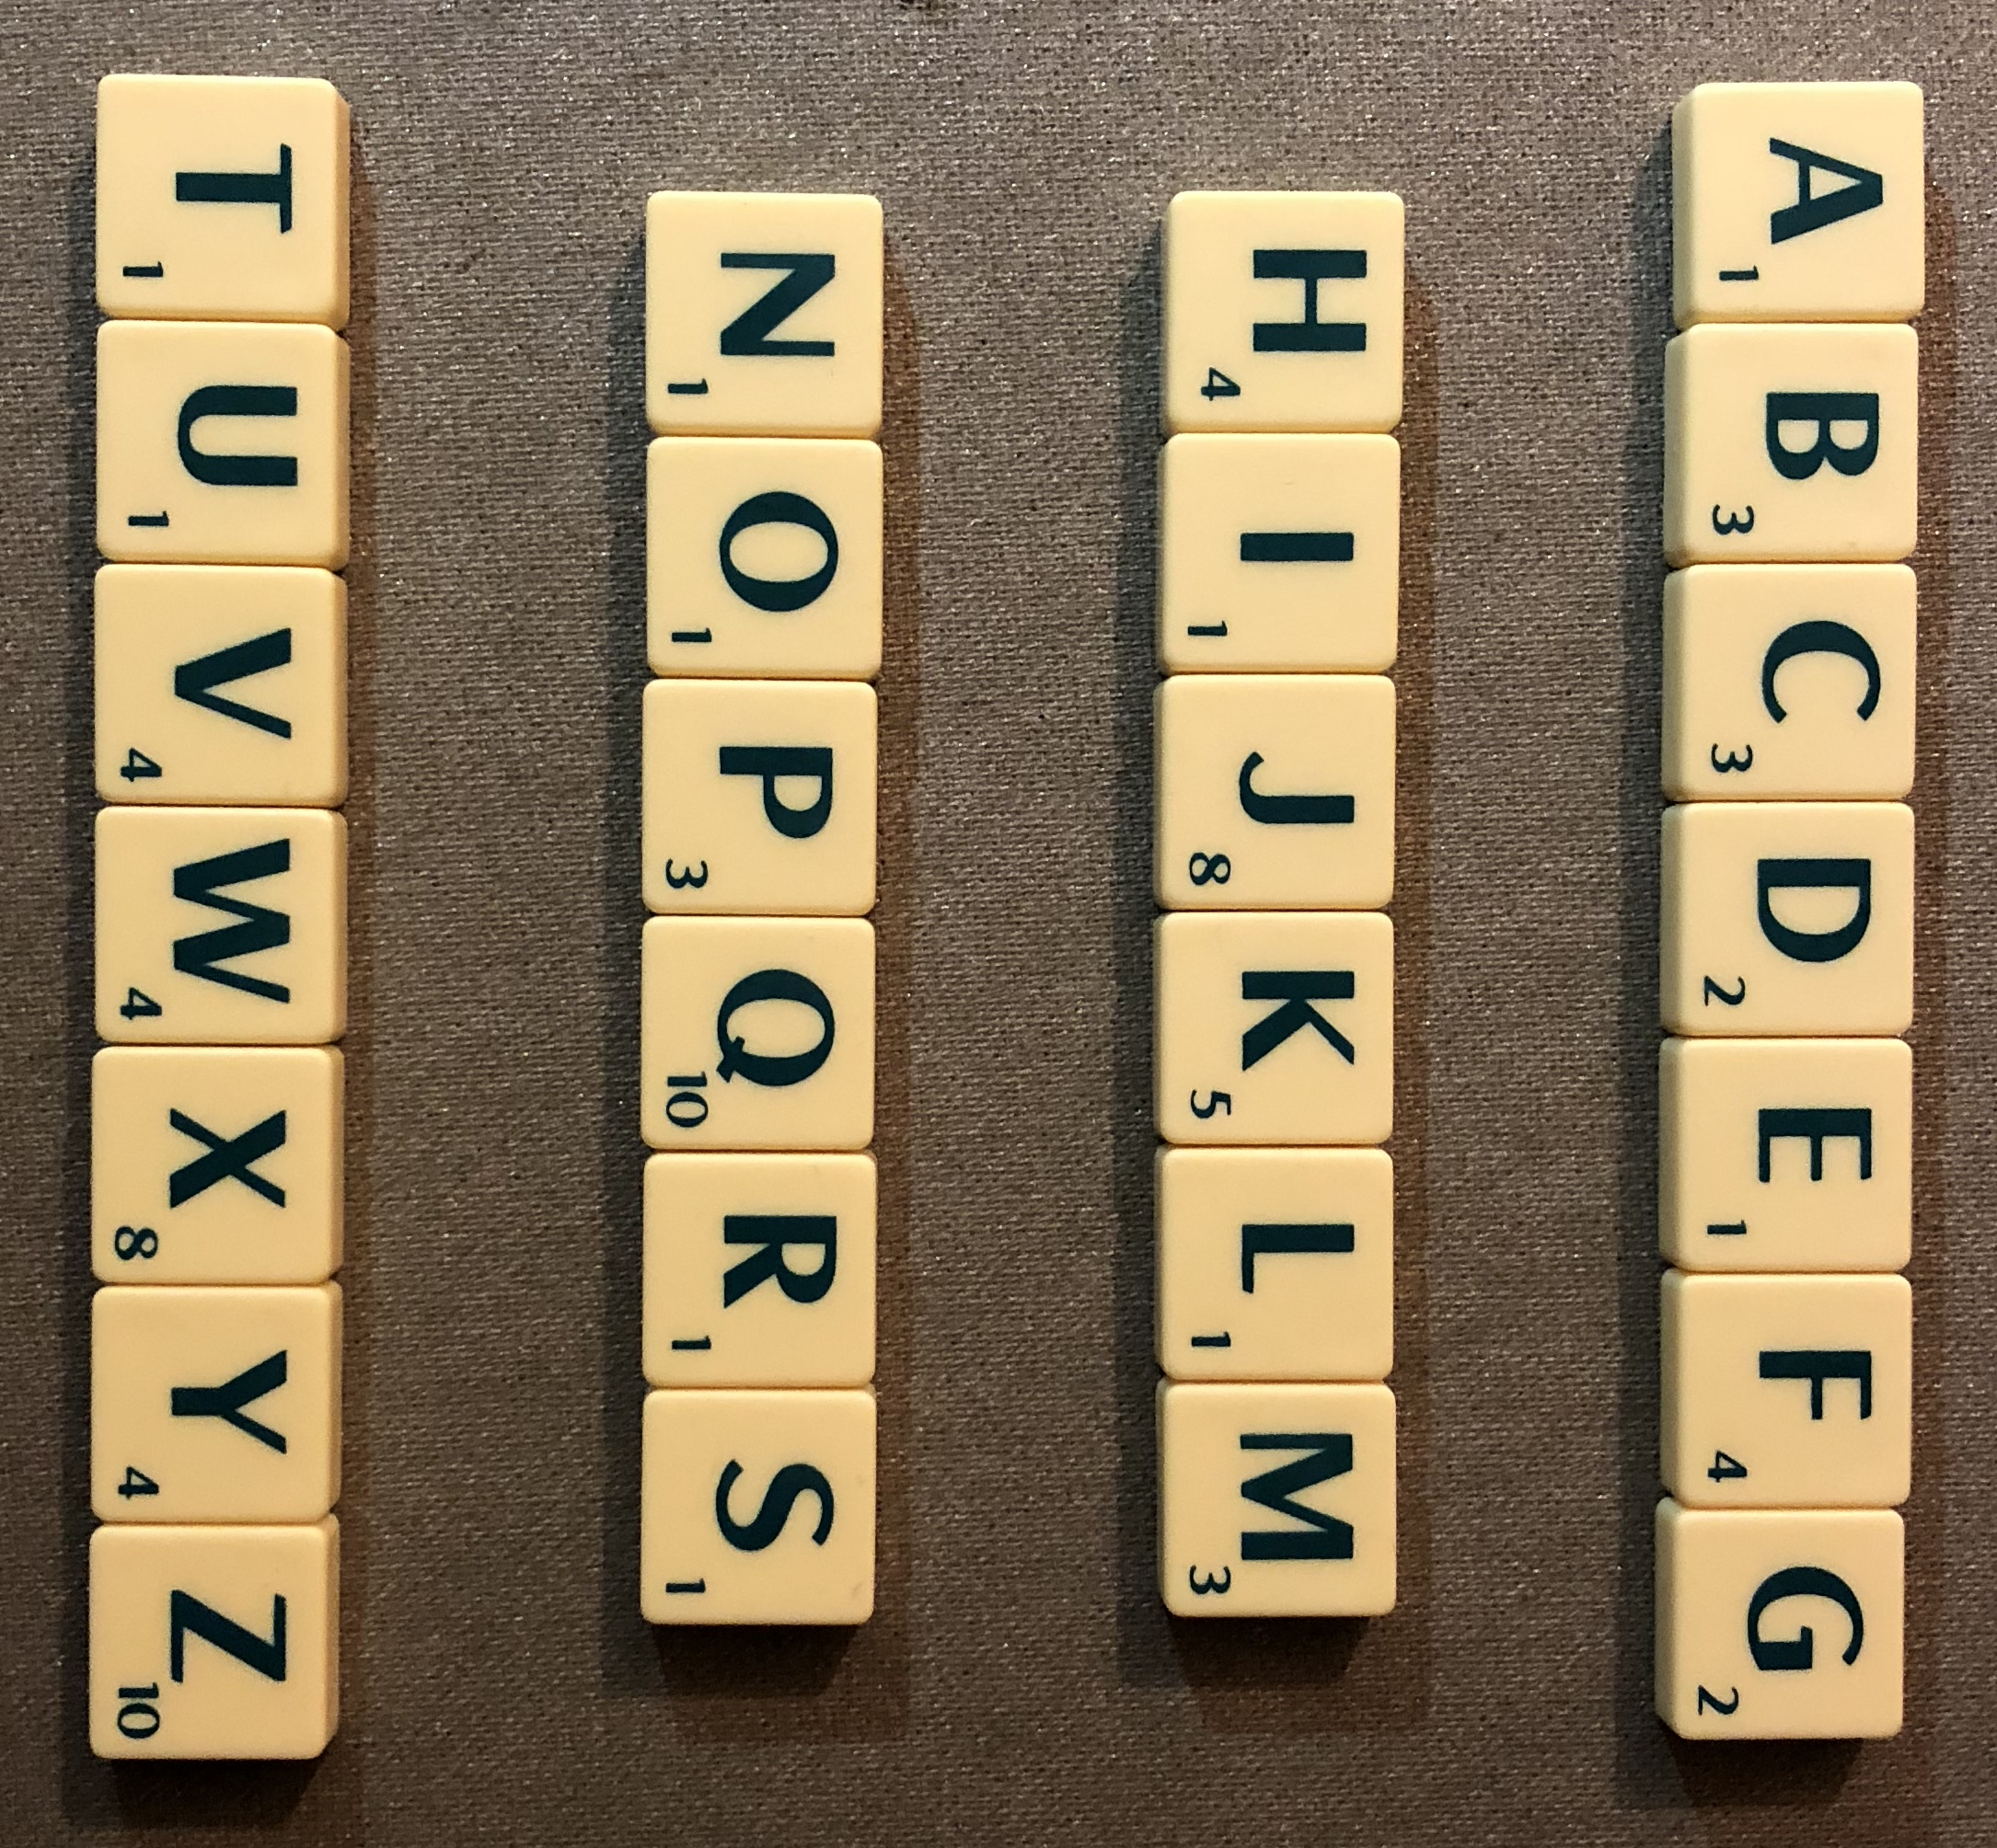
Los geht’s!

